Slide 1

Course on
Protein Networks and Systems Biology
14 – 18 December 2015
University of Bologna, IT
Three-dimensional modelling of protein complexes
Allegra Via
Biocomputing Unit
Sapienza Università, Rome, IT

Slide 2
Molecular structure of stable interactions: what information?
identification of interface residues/hot spots
details about the interface (solvent accessible surface area, shape, complementarity between surfaces, residue interface propensities, hydrophobicity, segmentation and secondary structure, and conformational changes on complex formation)
assignment of protein function
recognition of specific residue motifs

Slide 3
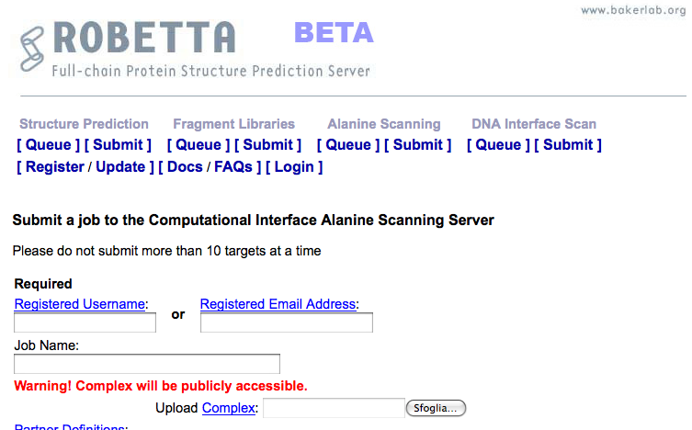
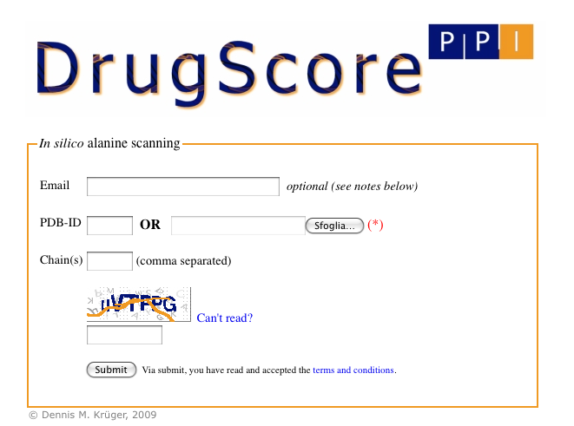
Computational alanine-scanning in protein-protein interfaces
http://robetta.bakerlab.org/alascansubmit.jsp
http://cpclab.uni-duesseldorf.de/dsppi/
DrugScorePPI and Robetta Alascanning are dedicated to the identification of hot spots at protein-protein interfaces

Slide 4
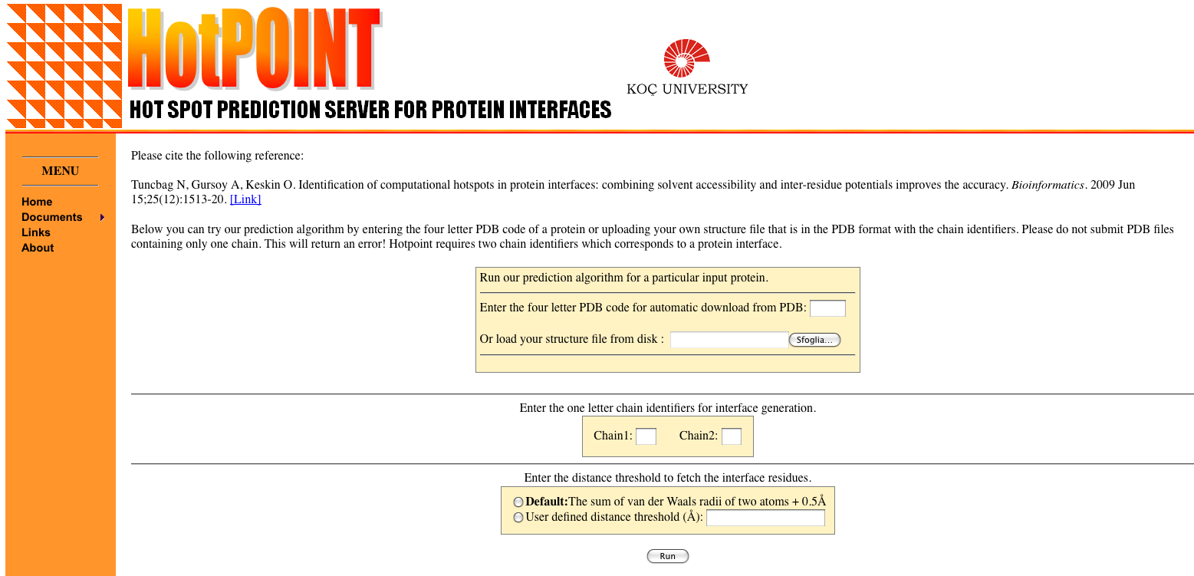
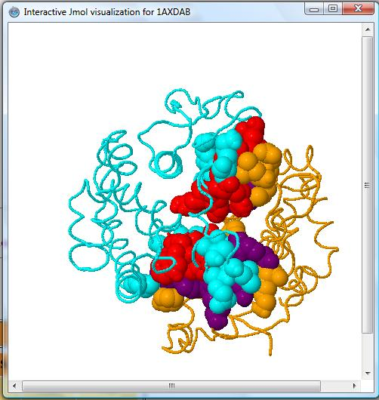
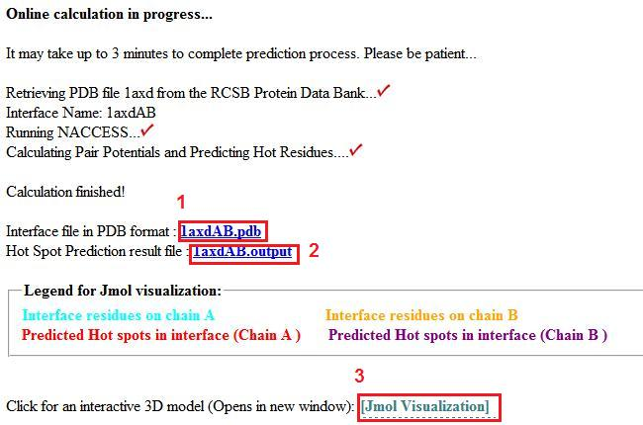
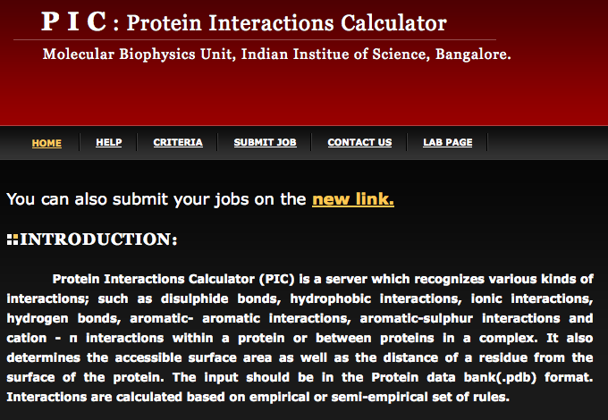
http://prism.ccbb.ku.edu.tr/hotpoint/
HotPOINT calculates solvent accessibilities and total contact potentials. It predicts hot spots at the complex interface
http://crick.mbu.iisc.ernet.in/~PIC/
PIC recognises various kinds of interactions, such as disulphide bonds, hydrophobic interactions, ionic interactions, hydrogen bonds, aromatic- aromatic interactions, aromatic-sulphur interactions and cation-π interactions between proteins in a complex

Slide 5
Prediction of protein-protein interactions
Phylogenetic profiling
Prediction of co-evolved protein pairs based on similar phylogenetic trees
Rosetta stone method
Association methods
Bayesian network modelling
Domain-pair exclusion analysis
Supervised learning problem
Gene fusion
Classification methods
Inference of interactions from homologous structures
Identification of structural patterns (hot spots)
Protein-protein docking

Slide 6
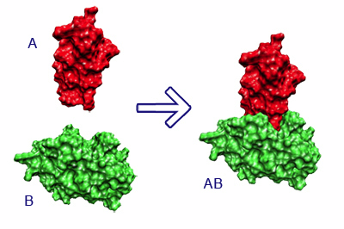
What is molecular docking?
Computational schemes that attempt to find the “best” matching between two molecules, a receptor and a ligand
The molecular docking problem can be defined as follows: given the atomic coordinates of two molecules, predict their “correct” bound association
Halperin et al. Proteins, 2002

Slide 7
Protein-protein docking: modelling the structure of protein complexes
Used to model the quaternary structure of complexes formed by two or more interacting proteins
It is the “gold standard” for prediction of PPIs
It makes it possible to figure out if two proteins interact and also how the interaction takes place ("mode" of binding)
It is computationally very challenging and thus very unlikely to be applied for high throughput purposes
Ngounou Wetie et al. Proteomics, 2013

Slide 8
What types of questions can docking address?
Do proteins A (receptor) and B (ligand) bind in vivo?
If they do bind:
What is the spatial configuration they adopt in their bound state?
What is the structure of the protein complex (near-native structure) in atomic details ?
How strong or weak is their interaction (which types of interactions are present)?
What is the orientation that maximises the interaction, minimising the energy of the complex?
If they don't bind:
Would they bind if there was a mutation?

Slide 9
Docking prerequisites
The molecular structure (spatial coordinates) of the interacting partners
has been determined experimentally
or
can be "safely" predicted
Computing power

Slide 10
"Bound" docking
Schemes that attempt to reconstruct a complex using the bound structures of the receptor and the ligand
After artificial separation of the receptor and the ligand, the goal is to reconstruct the native complex
No conformational changes are involved
Used as first test to validate the algorithm

Slide 11
"Unbound" or "predictive" docking
Schemes that attempt to reconstruct a complex using the unbound structures of the receptor and the ligand
An "unbound" structure maybe a native structure, a pseudo-native structure, or a modelled structure
Native: free in solution, in its uncomplexed state
Pseudo-native: structure complexed with a molecule different from the one used for the docking
Halperin et al. Proteins, 2002

Slide 12
Unbound docking
It is far more complex than bound docking
Problems: conformational changes (side-chains and backbone movements), experimental errors in the structures, reliability of models.

Slide 13
The three key ingredients in docking

Slide 14
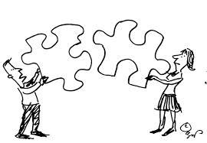

Slide 15
The three key ingredients in docking
Representation of the system
Conformational space search
Ranking of potential solutions

Slide 16
Representation of the system
Docking essentially simulates the interaction of the protein surface
How do we define a protein surface?
Mathematical models (e.g. geometrical shape descriptors, a grid)
Static or dynamic treatment of the protein frame (rigid vs flexible)
The choice of the system (surface) representation decides the types of conformational search algorithms, and the ways to rank potential solutions

Slide 17
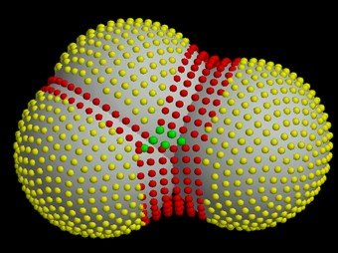
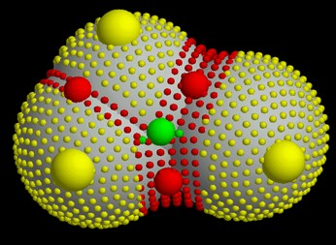
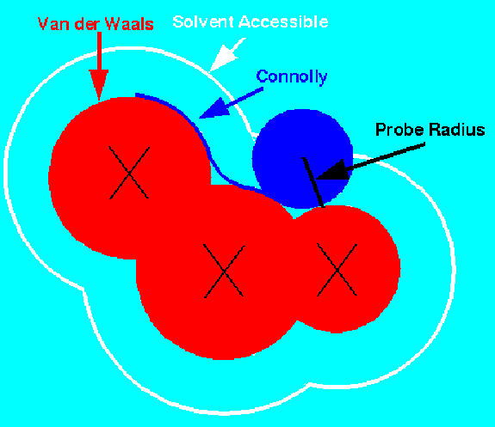
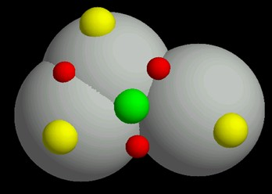
Surface representation
Dense surface (Connolly)
Sparse surface (Shuo Lin et al.)
http://www.chem.leeds.ac.uk/ICAMS/eccc/cangaroo.html

Slide 18
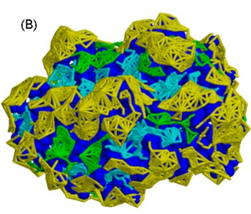
Patch detection
Divide the surface into connected, non-intersecting, equal sized patches of critical points with similar curvature
Yellow: knob patches
Cyan: hole patches
Green: flat patches
Blue: protein

Slide 19
Conformational space search
Efficient search algorithm
Speed and effectiveness in covering the relevant conformational space
Computationally difficult - there are many ways to put two molecules together (3 translational + 3 rotational degrees of freedom)
Goal: locate the most stable state (global minimum) in the energy landscape

Slide 20
Forces governing biomolecular recognition
Van der Waals
Electrostatics
Hydrophobic contacts
Hydrogen bonds
Salt bridges
All interactions act at short ranges → surface complementarity is needed for tight binding
Efrat Mashiach, http://bioinfo3d.cs.tau.ac.il/

Slide 21
Shape complementarity

Slide 22
Rigid vs flexible docking
Rigid body is a highly simplistic model that regards the two proteins as two rigid solid bodies
The semi-flexible model is asymmetric; one of the molecules is considered flexible, while the receptor is regarded as rigid
Flexible docking. Both molecules are considered flexible, though flexibility is limited or simplified

Slide 23
Docking algorithms
Rigid docking
fast → can explore the entire receptor and ligand surfaces
Less accurate
flexibility = "soft" belt into which atoms can penetrate
Flexible docking
Slower
More accurate
Can model side-chain/backbone flexibility
highly reliable but too slow for extensive ligand docking

Slide 24
Docking approaches
scan of the entire solution space in a predefined systematic manner
e.g., complete searches of all orientations between two rigid molecules by systematically rotating and translating one molecule about the other
2) a gradual guided progression through solution space. Only part of the solution space is searched, or fitting solutions are generated.
e.g., Monte Carlo, simulated annealing, molecular dynamics (MD), and evolutionary algorithms.
3) Data-driven docking – it uses the available information about binding site/interface residues

Slide 25
Docking approaches
Although each method is optimal for a specific class of protein docking problems, combining computational steps from different methods can improve the reliability and accuracy of results.
Global methods work well when none of the interacting partners undergo conformational changes larger than 2 A. In particular, when no prior information on the complex is available, requirig the search of the entire conformational space.
Monte Carlo methods yeld good results when side-chain repacking is crucial, e.g., when one of the protein structures is a homology model.
Data-driven methods produce the best results if sufficient information on interface resdiues is available, even when the binding causes large conformational change, including the backbone.

Slide 26
Ranking of potential solutions
A search algorithm may produce an immense number of solutions (10⁹)
Goal: discriminate between "correct" native solutions, i.e., with low rmsd from the crystal structure and others within reasonable computation time
good scoring function → fast enough to allow its application to a large number of potential solutions
effectively discriminates between native and non-native docked conformations
should include and appropriately weight all the energetic ingredients

Slide 27
To solve the docking problem, ideally, the best matching algorithms and scoring schemes should be combined
Two-stage ranking:
fast scoring to rapidly scan possible solutions and obtain initial "good" candidates – mostly geometric criteria
Followed by more advanced methods to further discriminate the limited conformations - energy criteria

Slide 28
Algorithms can be classified by the stage of scoring in the algorithm flow
Integrated functions – scoring is integrated into the search stage and filter emerging solutions – the scoring function is part of the design
Edge functions – scoring is applied at the end of the search stage

Slide 29
Parameters used for scoring
Geometric complementarity - how to score complementarity is strongly coupled with the surface representation
Intermolecular overlap – tolerance to slight interface clashes and penalty for protein interior clashes (surface "belt" of nonpenalised penetration area)
Intra-molecular overlap – when backbone flexibility is taken into account
Hydrogen bonding
Contact area: total interactions = hh + pp + hp (h = hydrophobic, p = polar)
Pairwise aa and atom-atom contacts – empirical term derived form observed statistical frequency of aa contacts in X-ray proteins
Electrostatic interactions and solvation energy

Slide 30
Binding site information may be included in scoring
Knowledge of the location of the binding site on one or both proteins drastically reduces the number of possible solutions
Knowledge of the specific binding site residues reduces the search space even further
Info about active site residues: site directed mutagenesis, chemical cross-linking, phylogenetic data
Sometimes the binding site can be predicted
For some families the major binding sites are known in advance (e.g. serine proteases and immunoglobulins)

Slide 31
Kozakov et al, Biophys J, 2005
Clustering of solutions
Events that occur in clusters are probably not random
Clustering occurs because long-range electrostatic and/or desolvation forces steer the proteins to a low free-energy attractor at the binding region
Considering a free-energy surface with multiple minima, it is obvious that conformations with free energies below a certain threshold will form a number of clusters
The cluster with the largest number of low-energy structures is typically the native fold, the center of the most populated cluster being a structure near the native binding site
Looking for large clusters is a major tool of finding near-native conformations

Slide 32
Conclusion I (-)
The molecular docking problem is far from being solved
It is difficult to find very specific properties of protein-protein interfaces
Results are generally poor with weakily interacting proteins
Proteins are flexible and may undergo even large conformational changes upon binding
Exhaustive space searches provide too many conformations
Accurate interaction energies are too complicated to compute

Slide 33
Conclusion II (-)
Despite some algorithms are able to rank correct solutions within the top ten predictions, for most complexes the highest ranked structures are still false positives (high rmsd from the complex)
No efficient method for reliable discrimination between correct solutions and FPs is currently available, in particular if the binding site is unknown
Many FPs displaying good surface complementarity are far from the native complex

Slide 34
Conclusion I (+)
If the conformational change is limited to surface side-chain atoms, rigid body algorithms have been remarkably successful, even in absence of knowledge of the binding site
Side-chain flexibility can be handled via a "soft" tolerance belt
"Docking in steps" is a promising strategy: initial rigid-body, entire surface algorithm followed by a dynamic method overcoming energy barriers
Integration of experimental information produces reliable docking results
Relatively easy for enzyme-inhibitor complexes
Sometimes good results with antigen-antibody pairs

Slide 35
How current protein docking programs work?
… all possible orientations of the two molecules are scanned (sampling ): hundreds to thousands of possible docked conformers (decoys ).“Soft” scoring function allowing for “overlaps”. The accuracy is limited
Conformations retained: 2000
Simplified/Rigid Body Search
Selecting conformations
Structure
refinement
Higher accuracy – some level of protein flexibility - clustering
Conformations retained: 30
Further optimisation – flexible interface side-chains, minimisation, MD, water.
Conformations retained: 15
Source: Current Opinion in Structural Biology

Slide 36
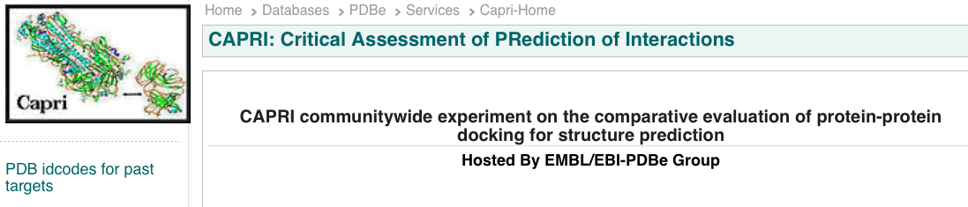
CAPRI: Critical Assessment of PRotein Interactions
http://www.ebi.ac.uk/msd-srv/capri/
CAPRI is a community-wide experiment in modelling the molecular structure of protein complexes
CAPRI is a blind prediction experiment aimed at testing the performance of protein docking methods
Rounds take place about every six months
Each round contains between one and six target protein–protein complexes whose structures have been recently determined experimentally
Targets are unpublished crystal or NMR structures of complexes, whose coordinates are held privately by the assessors, with the co-operation of the structural biologists who determined them
The atomic coordinates of the two proteins are given to groups for prediction

Slide 37

CAPRI: Critical Assessment of PRotein Interactions
The CAPRI experiment is double-blind
submitters do not know the solved structure
the assessors do not know the correspondence between a submission and the identity of its creator
International meetings
Proteins: Structure, Function, and Bioinformatics
Special CAPRI Issue: Fifth Meeting on the Critical
Assessment of Predicted Interactions
December 2013

Slide 38
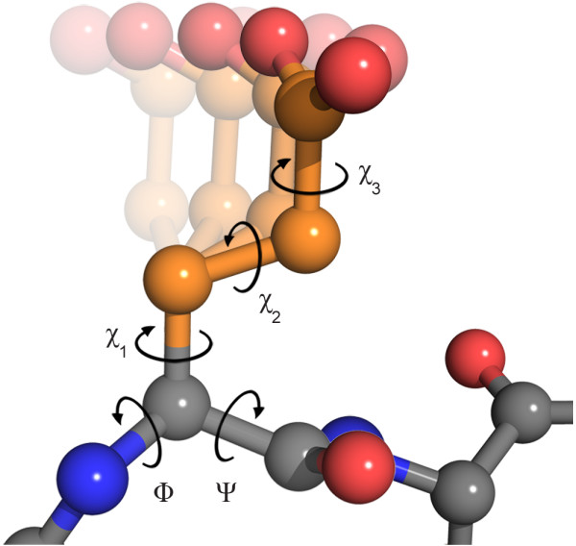
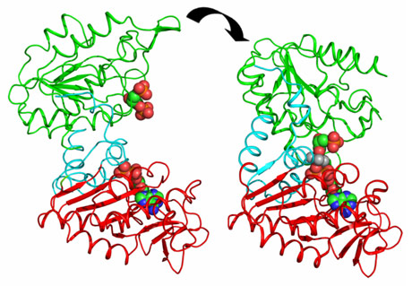
CAPRI drives the community to develop new techniques
Side-chain flexibility
First rounds the big challenge was to model correctly side-chain conformations
Dihedral angles in glutamate
Domain movements
Today the development is focused on backbone flexibilty
Domain movements in PGK catalysis.
J. Biol. Chem. (2011) 286, 14040-14048
The clustering application to protein-protein docking was first introduced in CAPRI by Camacho & Gatchell,D. (2003)

Slide 39

CAPRI experiment … who is the winner ??
There is no official ranking and in many cases the differences between the different algorithms are not huge

Slide 40
CAPRI experiment … who is the winner ??
HADDOCK (software/web server). http://haddock.chem.uu.nl
CLUSPRO (software/web server)
http://cluspro.bu.edu
ICM-pro (desktop-modeling environment)
http://www.molsoft.com/protein_protein_docking.html
ROSETTADOCK (software/web server) http://graylab.jhu.edu/docking/rosetta/
http://rosettadock.graylab.jhu.edu/submit
GRAMM-X (web server) http://vakser.bioinformatics.ku.edu/resources/gramm/grammx
PATCHDOCK/FIREDOCK (software/web server) http://bioinfo3d.cs.tau.ac.il/PatchDock/
HEX (software/web server) http://hexserver.loria.fr

Slide 42
The HADDOCK protocol
Rigid-body docking followed by
A semi-flexible refinement of the interface in torsion angles' space (of both backbone and side-chains).
As a final stage, a Cartesian dynamics refinement in explicit solvent

Slide 43
The HADDOCK services
the Easy interface
the Prediction interface
the Expert interface (requires Expert level access)
the Refinement interface (requires Expert level access)
the Guru interface (requires Guru level access)
the Multi-body interface (requires Guru level access)
the File upload interface

Slide 44
The EASY interface

Slide 45
The EXPERT interface

Slide 46
The GURU interface

Slide 47
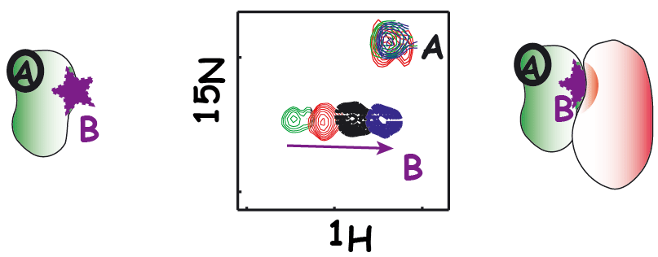
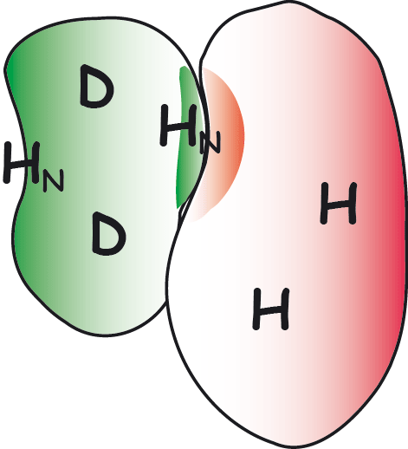
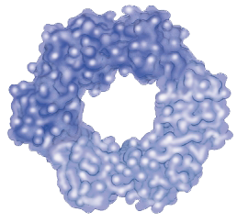
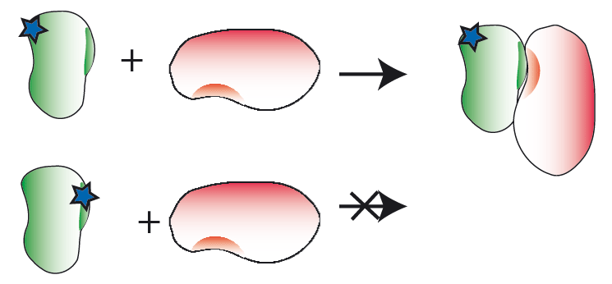
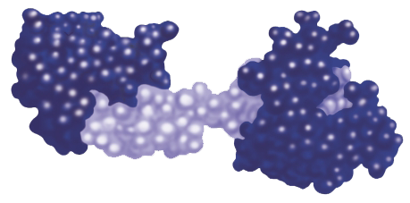
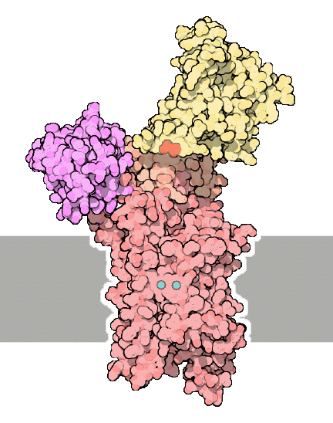
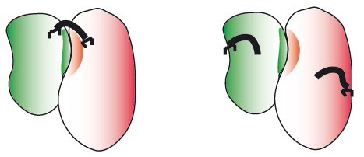
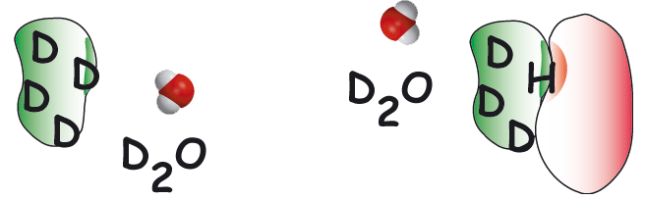
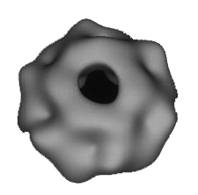
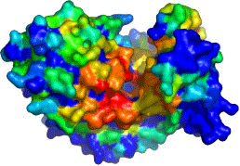
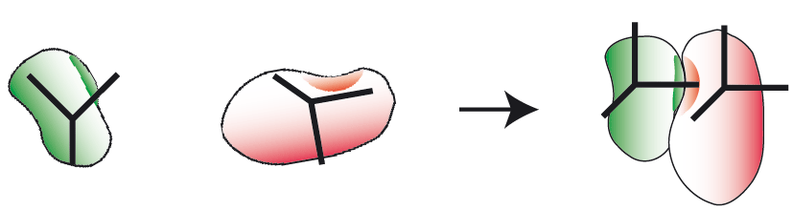
NMR titrations
NMR crosssaturation
mutagenesis
Cross-linking
HADDOCK
High Ambiguity Driven DOCKing
x
B
y
j
z
H/D exchange
A
i
k
d_{iAB}^{eff}
Other sources
e.g. SAXS, cryoEM
Bioinformatic predictions
EFRGSFSHL
EFKGAFQHV
EFKVSWNHM
LFRLTWHHV
IYANKWAHV
EFEPSYPHI
NMR anisotropy data
RDCs, para-restraints, diffusion anisotropy
http://haddocking.org; http://www.nmr.chem.uu.nl/haddock

Slide 48
Parameters supported by the various HADDOCK web interfaces
de Vries et al., Nature Protocols, 2010

Slide 49
Example of HADDOCK output
In this case additional experimental information has to be taken into account to completely rule out alternatives to the highest-scoring solution
de Vries et al., Nature Protocols, 2010
Notes:
The top structure of the top cluster hase an interface RMSD of only 1.1 A to the first model of NMR structure. The second cluster in which oner component is 90° rotated has an HADDOCK score very similar, therefore in this case additional experimental information has to be taken into account to completely rule out alternatives to the highest-scoring solution.

Slide 52
ClusPro http://nrc.bu.edu/cluster
The first fully automated, web-based program for the computational docking of protein structures
The docking algorithms evaluate billions of putative complexes, retaining a preset number with favorable surface complementarities
A filtering method is then applied to this set of structures, selecting those with good electrostatic and desolvation free energies for further clustering
The program output is a short list of putative complexes ranked according to their clustering properties

Slide 53
ClusPro http://nrc.bu.edu/cluster
User Input: PDB files of the 2 protein structures
Output: 10 (default) top predictions of docked conformations close to the native structure
Rigid body docking is performed using 2 established FFT-based docking programs (DOT and ZDOCK)
The scoring is solely based on the surface complementarity between the two structures
Over 2.7 10¹⁰ structures are evaluated, retaining 20 000 structures with the best surface complementarity scores, which are then further subjected to an empirical free energy filtering algorithm

Slide 54
ClusPro http://nrc.bu.edu/cluster
The free energy of the complex structure is typically dominated by van der Waals interactions, which is a very noisy function and difficult to calculate, especially with incorrect side-chain rotamers
Therefore, other components of the binding free energy are used to account for the noise of the van der Waals energies
Desolvation free energy using the atomic contact potential (statistical measure of the desolvation free energy)
Electrostatic free energy using a Coulombic model with a distance-dependent dielectric of 4r

Slide 55
ClusPro http://nrc.bu.edu/cluster
The top 2000 energetically favorable structures are clustered on the basis of a pairwise binding site root mean squared deviation (RMSD) criterion
Clusters are then formed by selecting the ligand that has the most neighbors below a previously selected clustering radius.
The ligand with the most neighbors is the cluster center, and is the representative structure for the cluster

Slide 56
